Slide 1


The Fourier Transform
Jean Baptiste Joseph Fourier

Slide 2
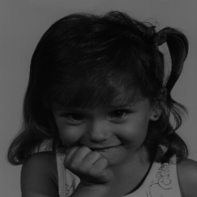
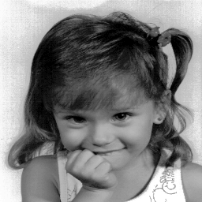
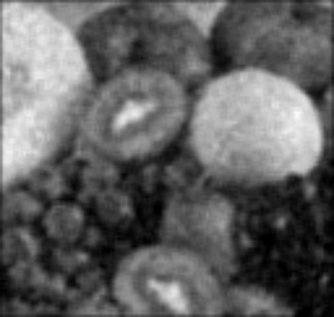

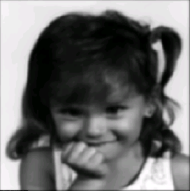
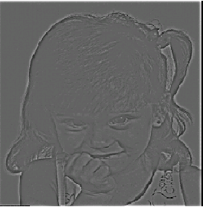
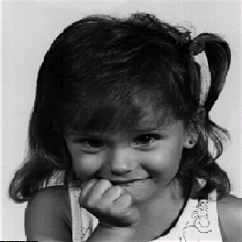
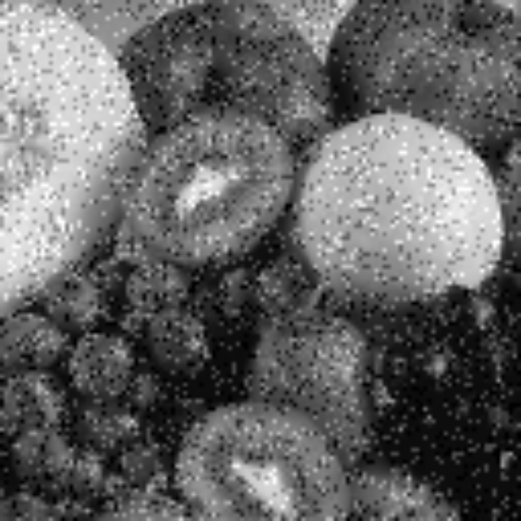
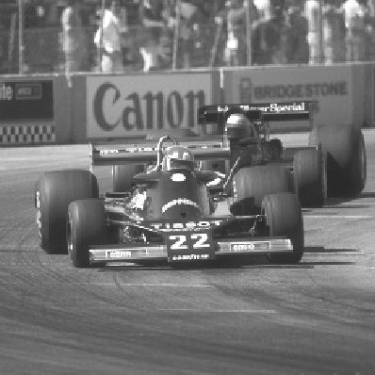
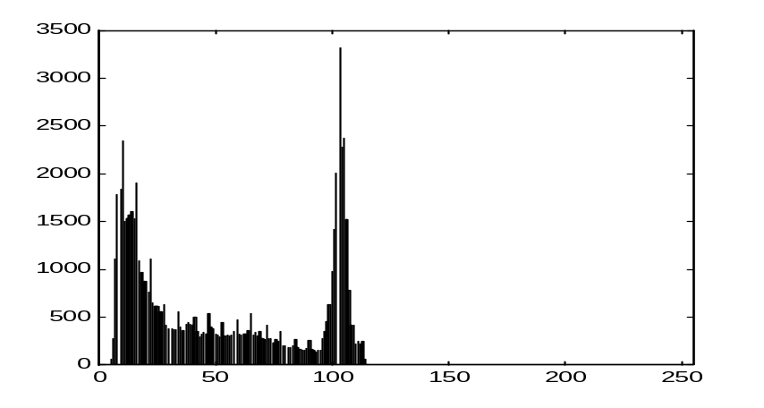
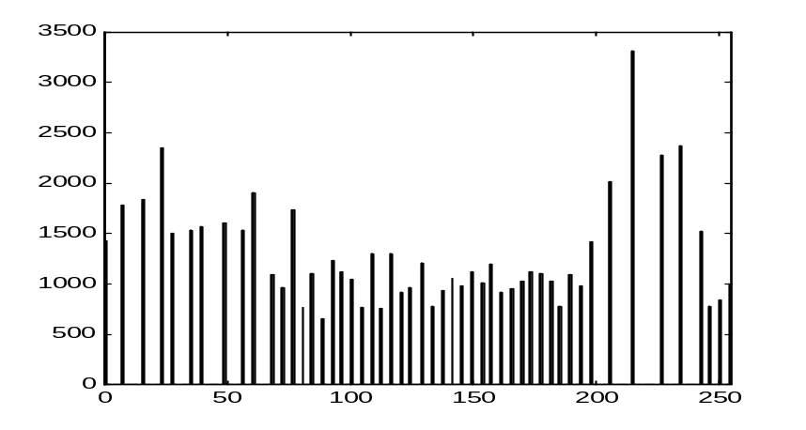
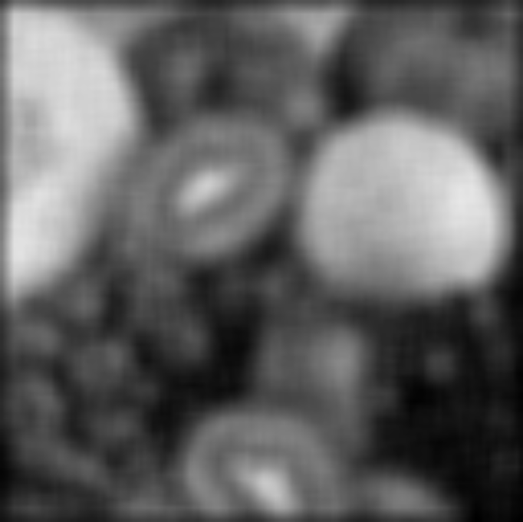
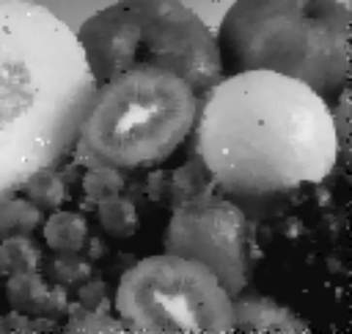

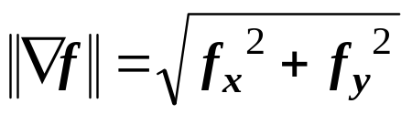
Image Operations in Different Domains
1) Gray value (histogram) domain
2) Spatial (image) domain
3) Frequency (Fourier) domain
- Histogram stretching, equalization, specification, etc...
- Average filter, median filter, gradient, laplacian, etc…
+
3 X 3 Average
=
5 X 5 Average
Original histogram
Equalized histogram
Noisy image
(Salt & Pepper noise)
Original image
Gradient magnitude
Blurry Image
Laplacian
Sharpened Image
7 X 7 Average
Median

Slide 3
A sum of sines and cosines
=
A
sin(x)
A
3 sin(x)
+ 1 sin(3x)
B
A+B
+ 0.8 sin(5x)
C
A+B+C
+ 0.4 sin(7x)
D
A+B+C+D
Notes:
Accept without proof that every function is a sum of
sines/cosines
As frequency increases – more details are added
Low frequency – main details
Hight frequency – fine details
Coef decreases with the frequency

Slide 4
Higher frequencies due
to sharp image variations
(e.g., edges, noise, etc.)

Slide 5
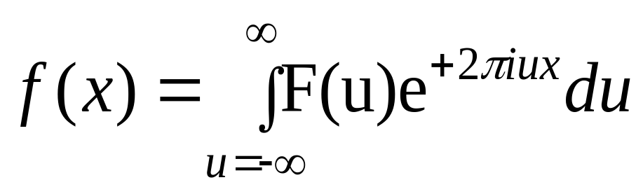
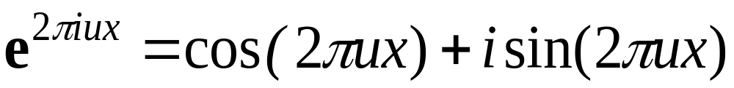
The Continuous Fourier Transform

Slide 6
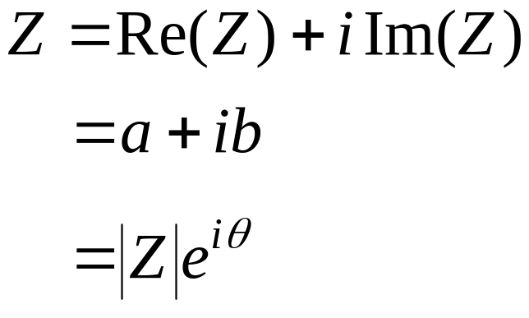
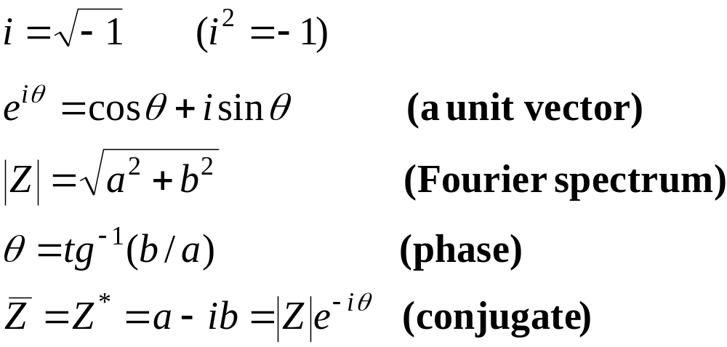
Complex Numbers
Imaginary
Z=(a,b)
b
|Z|
θ
a
Real

Slide 7
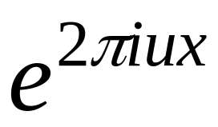
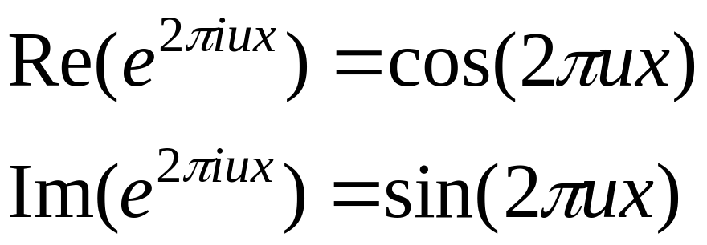

The 1D Basis Functions
1
x
1/u
The wavelength is 1/u .
The frequency is u .

Slide 8
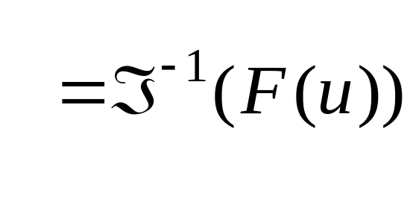
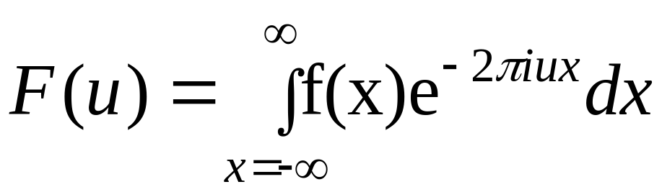
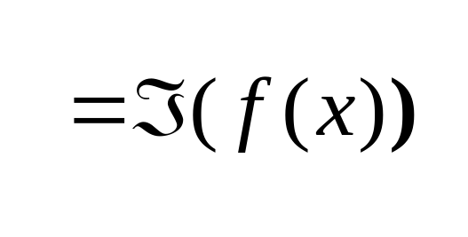
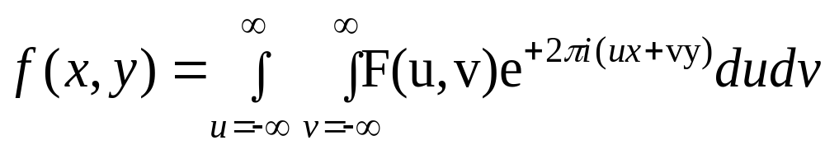
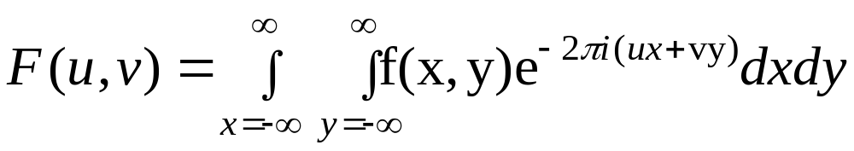
The Continuous Fourier Transform
1D Continuous Fourier Transform:
The Inverse
Fourier
Transform
The Fourier
Transform
2D Continuous Fourier Transform:
The Inverse Transform
The Transform

Slide 9
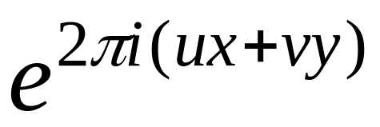
























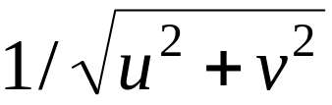
The 2D Basis Functions
V
u=-2, v=2
u=-1, v=2
u=0, v=2
u=1, v=2
u=2, v=2
u=-2, v=1
u=-1, v=1
u=0, v=1
u=1, v=1
u=2, v=1
U
u=-2, v=0
u=-1, v=0
u=0, v=0
u=1, v=0
u=2, v=0
u=-2, v=-1
u=-1, v=-1
u=0, v=-1
u=1, v=-1
u=2, v=-1
u=-2, v=-2
u=-1, v=-2
u=0, v=-2
u=1, v=-2
u=2, v=-2
The wavelength is . The direction is u/v .

Slide 10
Discrete Functions
f(x)
f(n) = f(x₀ + nΔx)
f(x₀+2Δx)
f(x₀+3Δx)
f(x₀+Δx)
f(x₀)
x₀
x₀+Δx
x₀+2Δx
x₀+3Δx
0 1 2 3 ... N-1
The discrete function f:
{ f(0), f(1), f(2), … , f(N-1) }

Slide 11
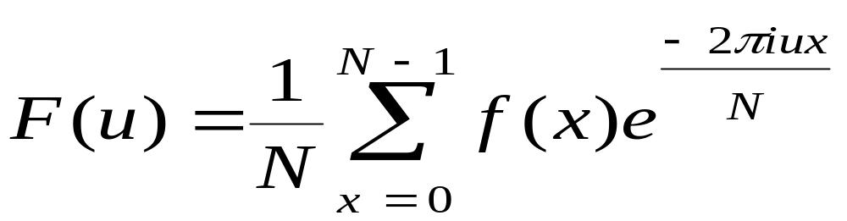
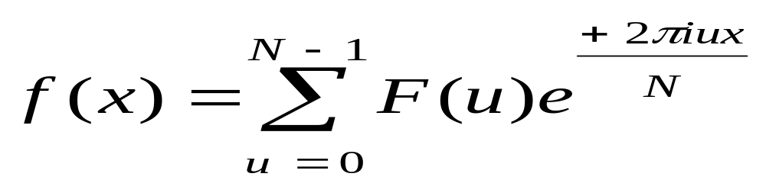
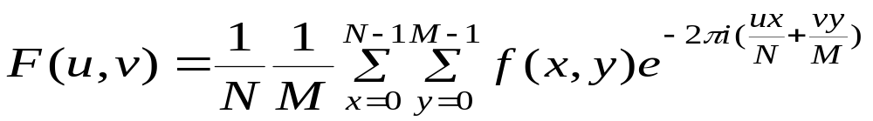
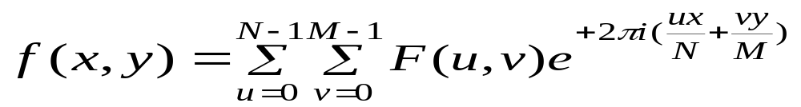
The Discrete Fourier Transform
1D Discrete Fourier Transform:
(u = 0,..., N-1)
(x = 0,..., N-1)
2D Discrete Fourier Transform:
(u = 0,..., N-1; v = 0,…,M-1)
(x = 0,..., N-1; y = 0,…,M-1)

Slide 12
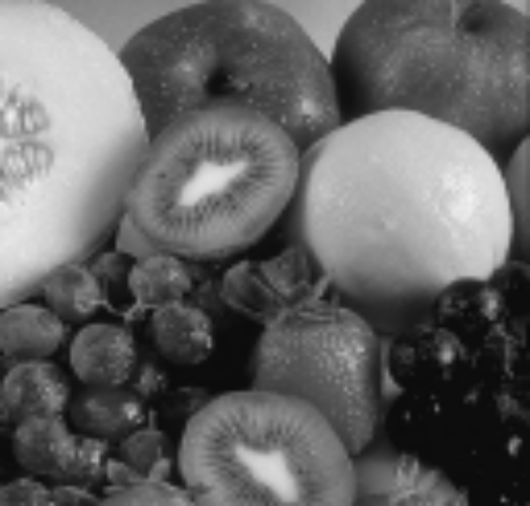
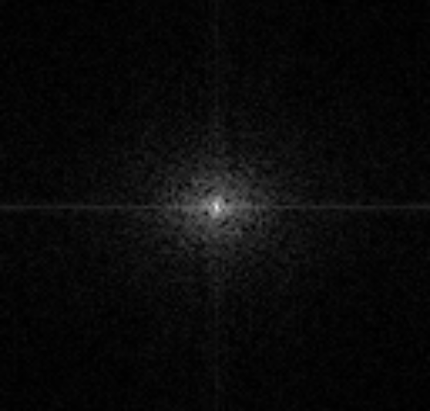
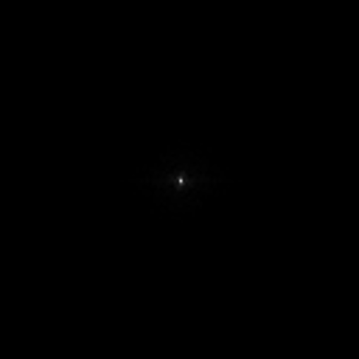
The Fourier Image
Fourier spectrum |F(u,v)|
Image f
Fourier spectrum log(1 + |F(u,v)|)

Slide 13
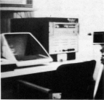
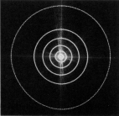
Frequency Bands
Image
Fourier Spectrum
Percentage of image power enclosed in circles (small to large) :
90%, 95%, 98%, 99%, 99.5%, 99.9%

Slide 14
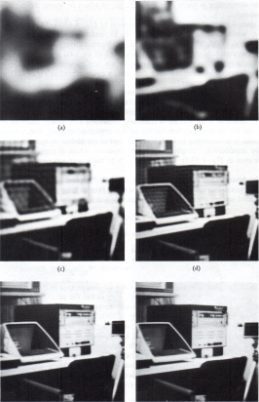
Low pass Filtering
90%
95%
98%
99%
99.5%
99.9%

Slide 15
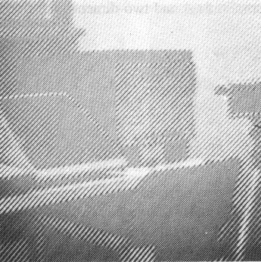
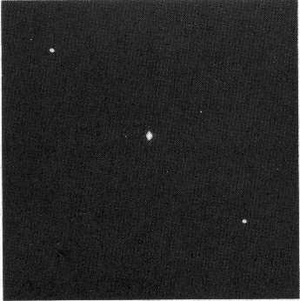
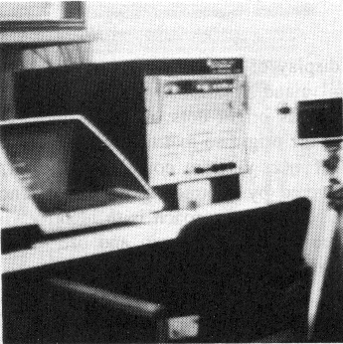
Noise Removal
Noisy image
Fourier Spectrum
Noise-cleaned image

Slide 16
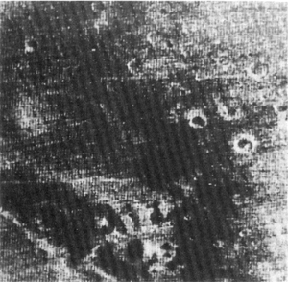
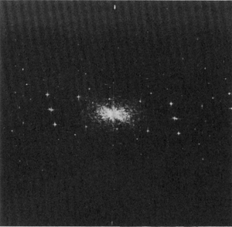
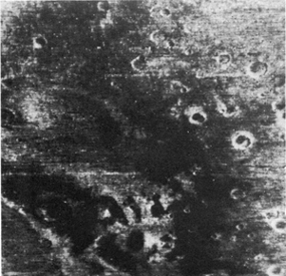
Noise Removal
Noisy image
Fourier Spectrum
Noise-cleaned image

Slide 17
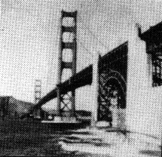
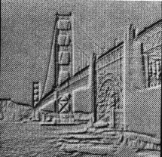
High Pass Filtering
Original
High Pass Filtered

Slide 18
High Frequency Emphasis
Original
+
High Pass Filtered

Slide 19
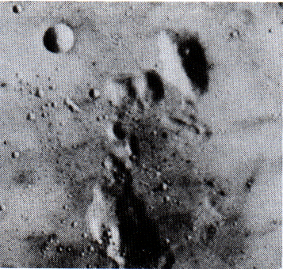
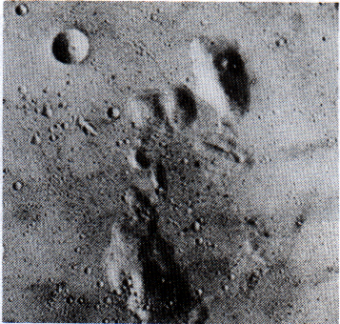
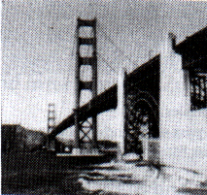
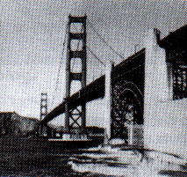
High Frequency Emphasis
Original
High Frequency Emphasis
High Frequency
Emphasis
Original

Slide 20
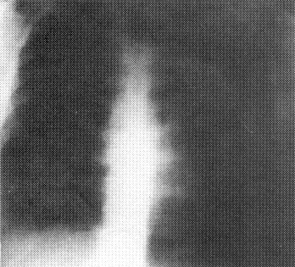
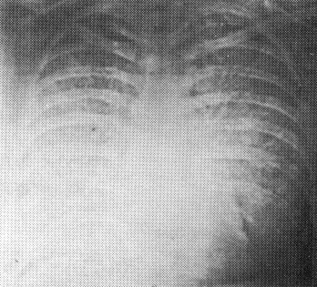


High Frequency Emphasis
Original
High pass Filter
High Frequency
Emphasis
High Frequency Emphasis
+
Histogram Equalization

Slide 21




Rotation
2D Image
2D Image - Rotated
Fourier Spectrum
Fourier Spectrum

Slide 22



Fourier Transform -- Examples
Image
Domain
Frequency
Domain

Slide 23


Fourier Transform -- Examples
Image
Fourier spectrum

